Slide 1
Chap 4. Lists, Stacks and Queue

Slide 2
Lists
A list is a finite, ordered sequence of data items.
Important concept: List elements have a position.
Notation: <a₀, a₁, …, a_{n-1}>
What operations should we implement?
Notes:
Students should already be familiar with lists.
Chapter objective: Use algorithm analysis in a familiar context to compare implementations.

Slide 3
List Implementation Concepts
Our list implementation will support the concept of a current position.
We will do this by defining the list in terms of left and right partitions.
  Either or both partitions may be empty.
Partitions are separated by the fence.
<20, 23 | 12, 15>

Slide 4
List ADT
template <class Elem> class List {
public:
virtual void clear() = 0;
virtual bool insert(const Elem&) = 0;
virtual bool append(const Elem&) = 0;
virtual bool remove(Elem&) = 0;
virtual void setStart() = 0;
virtual void setEnd() = 0;
virtual void prev() = 0;
virtual void next() = 0;
Notes:
This is an example ADT that our list implementations must match.

Slide 5
List ADT (cont)
virtual int leftLength() const = 0;
virtual int rightLength() const = 0;
virtual bool setPos(int pos) = 0;
virtual bool getValue(Elem&) const = 0;
virtual void print() const = 0;
};
Notes:
This is an example ADT that our list implementations must match.

Slide 6
List ADT Examples
List: <12 | 32, 15>
MyList.insert(99);
Result: <12 | 99, 32, 15>
Iterate through the whole list:
for (MyList.setStart(); MyList.getValue(it);
MyList.next())
DoSomething(it);

Slide 7
List Find Function
// Return true iff K is in list
bool find(List<int>& L, int K) {
int it;
for (L.setStart(); L.getValue(it); L.next())
if (K == it) return true; // Found it
return false; // Not found
}

Slide 8
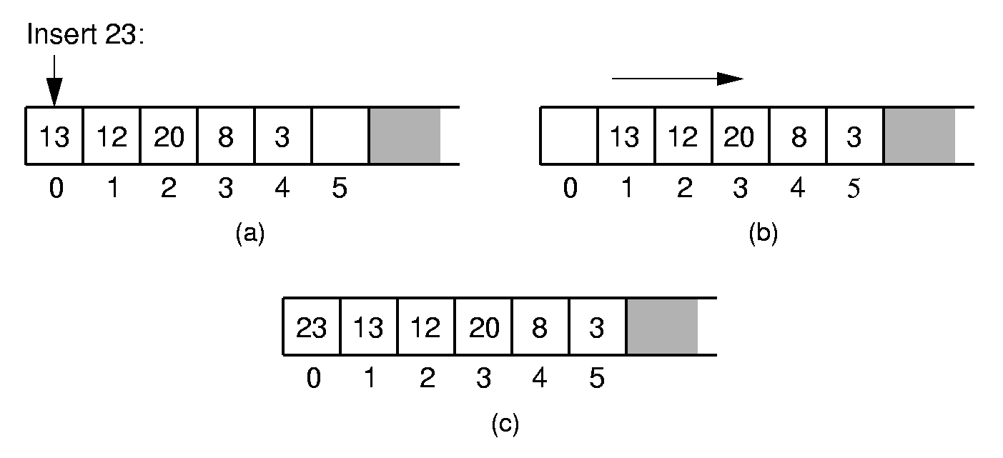
Array-Based List Insert
Notes:
Push items up/down. Cost: Θ(n).

Slide 9
Array-Based List Class (1)
template <class Elem> // Array-based list
class AList : public List<Elem> {
private:
int maxSize; // Maximum size of list
int listSize; // Actual elem count
int fence; // Position of fence
Elem* listArray; // Array holding list
public:
AList(int size=DefaultListSize) {
maxSize = size;
listSize = fence = 0;
listArray = new Elem[maxSize];
}

Slide 10
Array-Based List Class (2)
~AList() { delete [] listArray; }
void clear() {
delete [] listArray;
listSize = fence = 0;
listArray = new Elem[maxSize];
}
void setStart() { fence = 0; }
void setEnd() { fence = listSize; }
void prev() { if (fence != 0) fence--; }
void next() { if (fence <= listSize)
fence++; }
int leftLength() const { return fence; }
int rightLength() const
{ return listSize - fence; }

Slide 11
Array-Based List Class (3)
bool setPos(int pos) {
if ((pos >= 0) && (pos <= listSize))
fence = pos;
return (pos >= 0) && (pos <= listSize);
}
bool getValue(Elem& it) const {
if (rightLength() == 0) return false;
else {
it = listArray[fence];
return true;
}
}

Slide 12
Insert
// Insert at front of right partition
template <class Elem>
bool AList<Elem>::insert(const Elem& item) {
if (listSize == maxSize) return false; for(int i=listSize; i>fence; i--)
// Shift Elems up to make room
listArray[i] = listArray[i-1]; listArray[fence] = item;
listSize++; // Increment list size
return true;
}

Slide 13
Append
// Append Elem to end of the list
template <class Elem>
bool AList<Elem>::append(const Elem& item) {
if (listSize == maxSize) return false;
listArray[listSize++] = item;
return true;
}

Slide 14
Remove
// Remove and return first Elem in right
// partition
template <class Elem> bool AList<Elem>::remove(Elem& it) {
if (rightLength() == 0) return false;
it = listArray[fence]; // Copy Elem
for(int i=fence; i<listSize-1; i++)
// Shift them down
listArray[i] = listArray[i+1];
listSize--; // Decrement size
return true;
}

Slide 15
Link Class
Dynamic allocation of new list elements.
// Singly-linked list node
template <class Elem> class Link {
public:
Elem element; // Value for this node
Link *next; // Pointer to next node
Link(const Elem& elemval,
Link* nextval =NULL)
{ element = elemval; next = nextval; }
Link(Link* nextval =NULL)
{ next = nextval; }
};

Slide 16
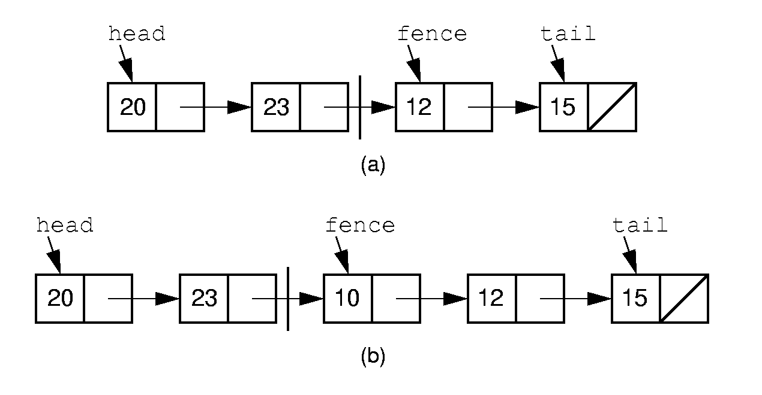
Linked List Position (1)
Notes:
Naïve approach: Fence points to first node in right partition. We want to insert 10 at the beginning of the right partition. No access if available to the node with value 23. How can we do the insert?

Slide 17
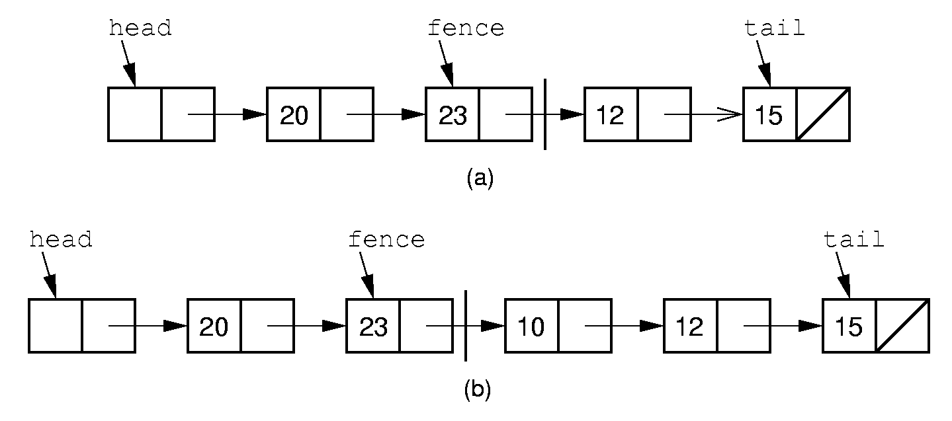
Linked List Position (2)
Notes:
Alternative Implementation: Fence points to the node preceding the actual first node in the right partition. Now we can do the insert. Also note use of the header node. The header node eliminates special cases in the code.

Slide 18
Linked List Class (1)
/ Linked list implementation
template <class Elem> class LList:
public List<Elem> {
private:
Link<Elem>* head; // Point to list header
Link<Elem>* tail; // Pointer to last Elem Link<Elem>* fence;// Last element on left
int leftcnt; // Size of left
int rightcnt; // Size of right
void init() { // Intialization routine
fence = tail = head = new Link<Elem>;
leftcnt = rightcnt = 0;
}

Slide 19
Linked List Class (2)
void removeall() { // Return link nodes to free store
while(head != NULL) {
fence = head;
head = head->next;
delete fence;
}
}
public:
LList(int size=DefaultListSize)
{ init(); }
~LList() { removeall(); } // Destructor
void clear() { removeall(); init(); }

Slide 20
Linked List Class (3)
void setStart() {
fence = head; rightcnt += leftcnt;
leftcnt = 0; }
void setEnd() {
fence = tail; leftcnt += rightcnt;
rightcnt = 0; }
void next() {
// Don't move fence if right empty
if (fence != tail) {
fence = fence->next; rightcnt--;
leftcnt++; }
}
int leftLength() const { return leftcnt; }
int rightLength() const { return rightcnt; }
bool getValue(Elem& it) const {
if(rightLength() == 0) return false;
it = fence->next->element;
return true; }

Slide 21
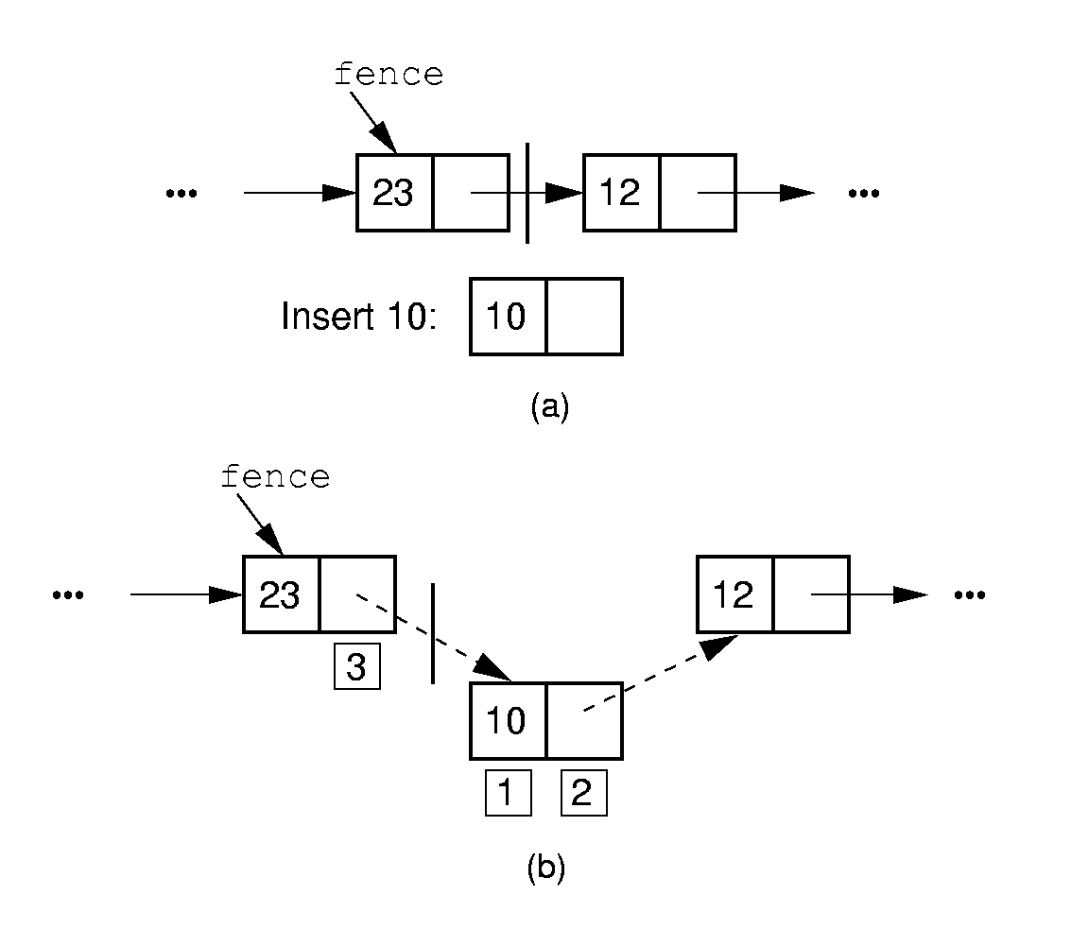
Insertion

Slide 22
Insert/Append
// Insert at front of right partition
template <class Elem>
bool LList<Elem>::insert(const Elem& item) {
fence->next =
new Link<Elem>(item, fence->next);
if (tail == fence) tail = fence->next; rightcnt++;
return true;}
// Append Elem to end of the list
template <class Elem>
bool LList<Elem>::append(const Elem& item) {
tail = tail->next =
new Link<Elem>(item, NULL);
rightcnt++;
return true;}

Slide 23
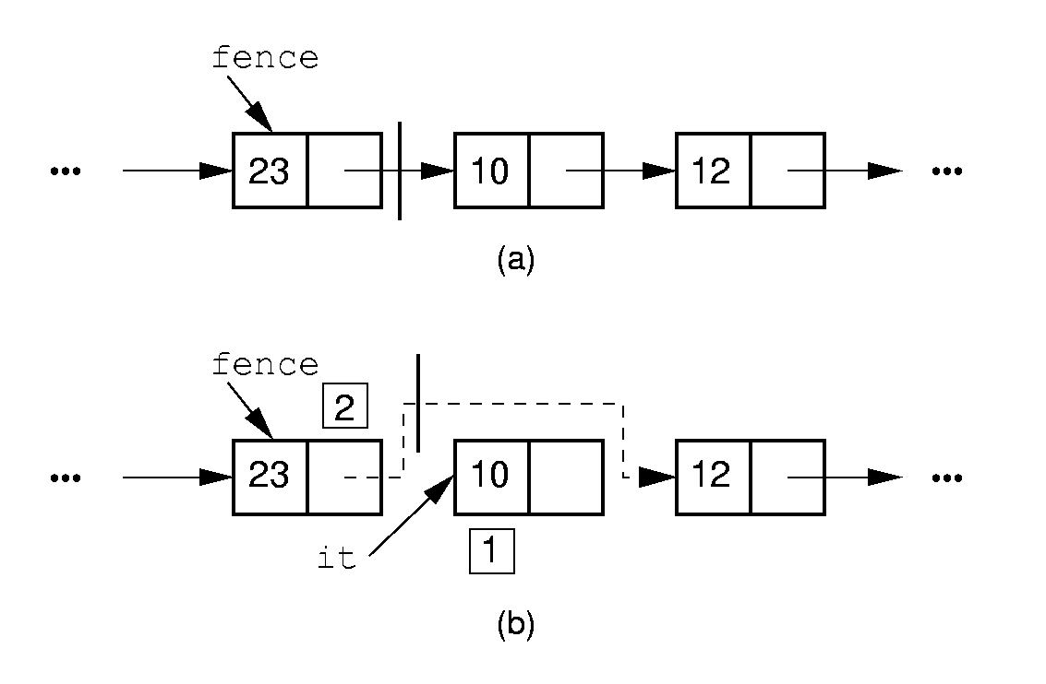
Removal

Slide 24
Remove
// Remove and return first Elem in right
// partition
template <class Elem> bool LList<Elem>::remove(Elem& it) {
if (fence->next == NULL) return false;
it = fence->next->element; // Remember val
// Remember link node
Link<Elem>* ltemp = fence->next;
fence->next = ltemp->next; // Remove
if (tail == ltemp) // Reset tail
tail = fence;
delete ltemp; // Reclaim space
rightcnt--;
return true;
}

Slide 25
Prev
// Move fence one step left;
// no change if left is empty
template <class Elem> void
LList<Elem>::prev() {
Link<Elem>* temp = head;
if (fence == head) return; // No prev Elem
while (temp->next!=fence)
temp=temp->next;
fence = temp;
leftcnt--;
rightcnt++;
}

Slide 26
Setpos
// Set the size of left partition to pos
template <class Elem>
bool LList<Elem>::setPos(int pos) {
if ((pos < 0) || (pos > rightcnt+leftcnt))
return false;
fence = head;
for(int i=0; i<pos; i++)
fence = fence->next;
return true;
}

Slide 27
Comparison of Implementations
Array-Based Lists:
Insertion and deletion are Θ(n).
Prev and direct access are Θ(1).
Array must be allocated in advance.
No overhead if all array positions are full.
Linked Lists:
Insertion and deletion are Θ(1).
Prev and direct access are Θ(n).
Space grows with number of elements.
Every element requires overhead.
Notes:
Applies to both average and worst cases.

Slide 28
Space Comparison
“Break-even” point:
DE = n(P + E);
n = DE
P + E
E: Space for data value.
P: Space for pointer.
D: Number of elements in array.

Slide 29
Freelists
System new and delete are slow.
// Singly-linked list node with freelist
template <class Elem> class Link {
private:
static Link<Elem>* freelist; // Head
public:
Elem element; // Value for this node
Link* next; // Point to next node Link(const Elem& elemval,
Link* nextval =NULL)
{ element = elemval; next = nextval; }
Link(Link* nextval =NULL) {next=nextval;}
void* operator new(size_t); // Overload
void operator delete(void*); // Overload
};

Slide 30
Freelists (2)
template <class Elem>
Link<Elem>* Link<Elem>::freelist = NULL;
template <class Elem> // Overload for new
void* Link<Elem>::operator new(size_t) {
if (freelist == NULL) return ::new Link;
Link<Elem>* temp = freelist; // Reuse
freelist = freelist->next;
return temp; // Return the link
}
template <class Elem> // Overload delete
void Link<Elem>::operator delete(void* ptr){
((Link<Elem>*)ptr)->next = freelist;
freelist = (Link<Elem>*)ptr;
}

Slide 31
Doubly Linked Lists
Simplify insertion and deletion: Add a prev pointer.
// Doubly-linked list link node
template <class Elem> class Link {
public:
Elem element; // Value for this node
Link *next; // Pointer to next node
Link *prev; // Pointer to previous node
Link(const Elem& e, Link* prevp =NULL,
Link* nextp =NULL)
{ element=e; prev=prevp; next=nextp; }
Link(Link* prevp =NULL, Link* nextp =NULL)
{ prev = prevp; next = nextp; }
};

Slide 32
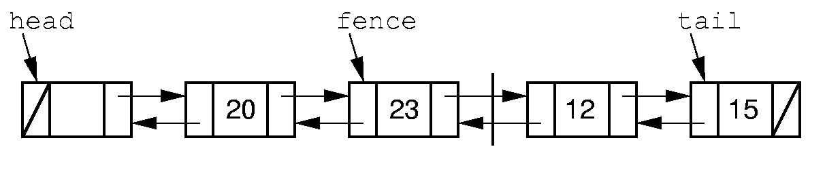
Doubly Linked Lists

Slide 33
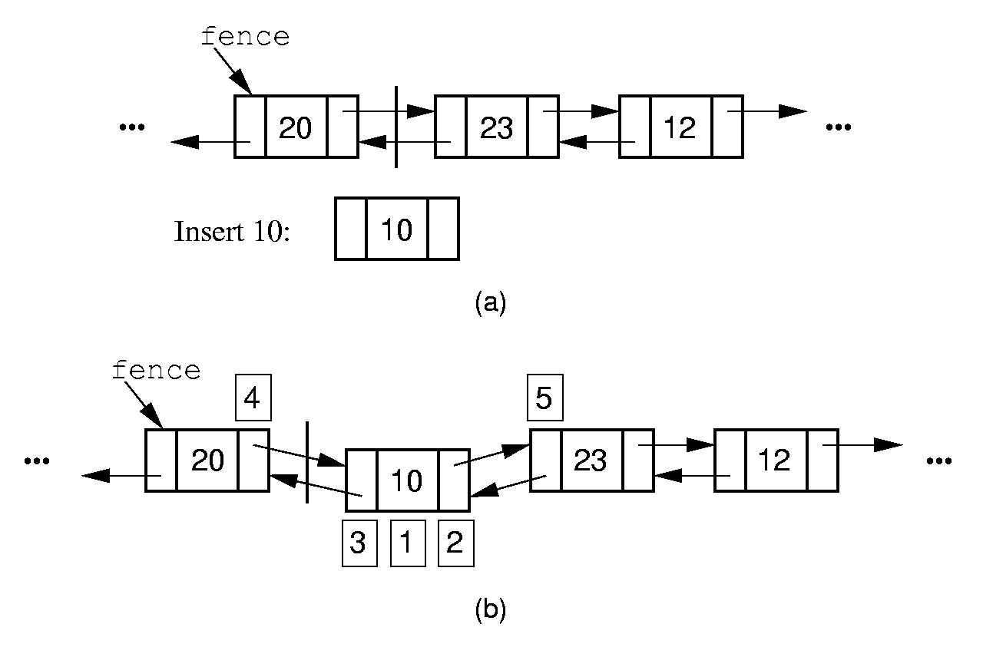
Doubly Linked Insert

Slide 34
Doubly Linked Insert
// Insert at front of right partition
template <class Elem>
bool LList<Elem>::insert(const Elem& item) {
fence->next =
new Link<Elem>(item, fence, fence->next);
if (fence->next->next != NULL)
fence->next->next->prev = fence->next;
if (tail == fence) // Appending new Elem
tail = fence->next; // so set tail
rightcnt++; // Added to right
return true;
}

Slide 35
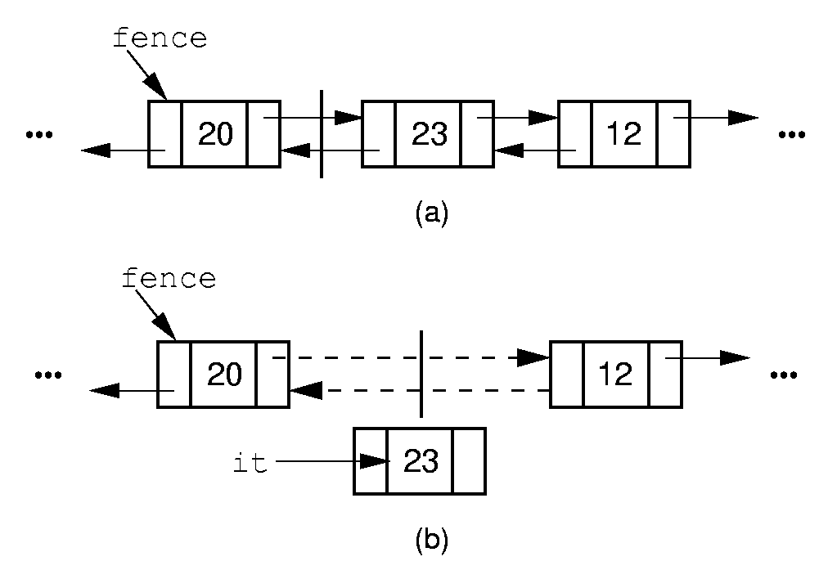
Doubly Linked Remove

Slide 36
Doubly Linked Remove
// Remove, return first Elem in right part
template <class Elem>
bool LList<Elem>::remove(Elem& it) {
if (fence->next == NULL) return false;
it = fence->next->element;
Link<Elem>* ltemp = fence->next;
if (ltemp->next != NULL)
ltemp->next->prev = fence;
else tail = fence; // Reset tail
fence->next = ltemp->next; // Remove delete ltemp; // Reclaim space
rightcnt--; // Removed from right
return true;
}

Slide 37
Dictionary
Often want to insert records, delete records, search for records.
Required concepts:
Search key: Describe what we are looking for
Key comparison
  Equality: sequential search
  Relative order: sorting
Record comparison
Notes:
Key: When describing what we are looking for, we don’t want to be required to describe the entire record, only one field of the record. If we already knew everything about the record, we probably wouldn’t need to look for it.

Slide 38
Comparator Class
How do we generalize comparison?
Use ==, <=, >=: Disastrous
Overload ==, <=, >=: Disastrous
Define a function with a standard name
  Implied obligation
  Breaks down with multiple key fields/indices for same object
Pass in a function
  Explicit obligation
  Function parameter
  Template parameter
Notes:
Here are some choices for implementing comparators. The first two are disastrous because the impose hidden, un-enforced requirements on the user. For the first, the user might provide an element type (such as strings) for which the operators are unsuitable. For the second, the user might neglect to overload the operators for the element class, and the compiler won’t catch the deficiency.
The third has more subtle problems. First, defining a standard name means the user can’t use that name him/herself. Second, it does not solve the problem of what to do when there are multiple indices for the same record, each comparing on different key fields. For example, two binary search trees used to search on a student employee ID record, one on GPA, another on salary.

Slide 39
Comparator Example
class intintCompare {
public:
static bool lt(int x, int y)
{ return x < y; }
static bool eq(int x, int y)
{ return x == y; }
static bool gt(int x, int y)
{ return x > y; }
};

Slide 40
Comparator Example (2)
class PayRoll {
public:
int ID;
char* name;
};
class IDCompare {
public:
static bool lt(Payroll& x, Payroll& y)
{ return x.ID < y.ID; }
};
class NameCompare {
public:
static bool lt(Payroll& x, Payroll& y)
{ return strcmp(x.name, y.name) < 0; }
};
Notes:
Here is an example of a class with two fields and two comparators. Note the example shows only the lt method, for brevity.

Slide 41
Dictionary ADT
// The Dictionary abstract class.
template <class Key, class Elem,
class KEComp, class EEComp>
class Dictionary {
public:
virtual void clear() = 0;
virtual bool insert(const Elem&) = 0;
virtual bool remove(const Key&, Elem&) = 0;
virtual bool removeAny(Elem&) = 0;
virtual bool find(const Key&, Elem&)
const = 0;
virtual int size() = 0;
};

Slide 42
Unsorted List Dictionary
template <class Key, class Elem,
class KEComp, class EEComp>
class UALdict : public
Dictionary<Key,Elem,KEComp,EEComp> {
private: AList<Elem>* list;
public:
bool remove(const Key& K, Elem& e) {
for(list->setStart(); list->getValue(e);
list->next())
if (KEComp::eq(K, e)) {
list->remove(e);
return true;
}
return false;
}
};
Notes:
Example implementation using the dictionary ADT and comparator. Only the remove method is shown, to illustrate use of the comparator class.

Slide 43
Stacks
LIFO: Last In, First Out.
Restricted form of list: Insert and remove only at front of list.
Notation:
Insert: PUSH
Remove: POP
The accessible element is called TOP.

Slide 44
Stack ADT
// Stack abtract class
template <class Elem> class Stack {
public:
// Reinitialize the stack
virtual void clear() = 0;
// Push an element onto the top of the stack.
virtual bool push(const Elem&) = 0;
// Remove the element at the top of the stack.
virtual bool pop(Elem&) = 0;
// Get a copy of the top element in the stack
virtual bool topValue(Elem&) const = 0;
// Return the number of elements in the stack.
virtual int length() const = 0;
};

Slide 45
Array-Based Stack
// Array-based stack implementation
private:
int size; // Maximum size of stack
int top; // Index for top element
Elem *listArray; // Array holding elements
Issues:
Which end is the top?
Where does “top” point to?
What is the cost of the operations?

Slide 46
Linked Stack
// Linked stack implementation
private:
Link<Elem>* top; // Pointer to first elem
int size; // Count number of elems
What is the cost of the operations?
How do space requirements compare to the array-based stack implementation?

Slide 47
examples of stack

Slide 48
栈的应用举例1: 数制转换
十进制数N和其他d进制数的转换是计算机实现计算的基本问题，其解决方法很多，其中一个简单算法基于下列原理：
迭代 N = (N div d)×d + N mod d
(其中：div 为整除运算，mod 为求余运算）
例如：（1348)10 = (2504)8 ，其运算过程如下：
N | N div 8 | N mod 8
1348 | 168 | 4
168 | 21 | 0
21 | 2 | 5
2 | 0 | 2

Slide 49
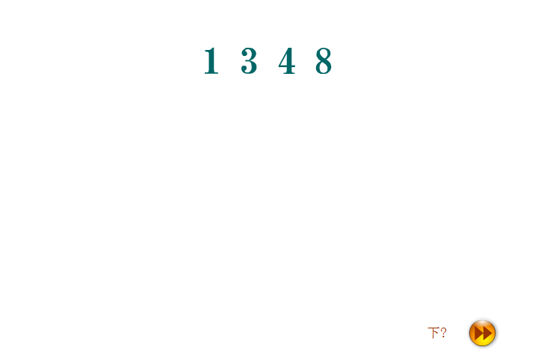

Slide 50
伪代码表示：
void conversion ()
{
InitStack( ); // 构造空栈
cin >> N; // 输入一个十进制数
while(N) {
Push(N % 8); // "余数"入栈
N = N / 8; // 非零"商"继续运算
} // while
while (!StackEmpty) {
// 和"求余"所得相逆的顺序输出八进制的各位数
Pop(e);
cout << e;
} // while
} // conversion

Slide 51
栈的应用举例2: 括号匹配的检验
处理的括号包括：{ } [ ] ( )
正确的格式：
{ [ ] ( ) }或[ ( { } [ ] ) ]
不正确的格式：
[ ( ] )或{ [ ( ] } )或 ( ( ) ] )
则 检验括号是否匹配的方法可用
“期待的急迫程度”这个概念来描述。

Slide 52
分析可能出现的不匹配的情况:
例如：考虑下列括号序列：
[ ( [ ] { } ) ]
1 2 3 4 5 6 7 8
到来的右括号并非是所“期待”的；
到来的是“不速之客”；
直到结束，也没有到来所“期待”的右括号。

Slide 53
算法的设计思想：
1）凡出现左括号，则进栈；
2）凡出现右括号，首先检查栈是否空
若栈空，则表明该“右括号”多余，
否则和栈顶元素比较，
若相匹配，则“左括号出栈” ，
否则表明不匹配。
3）表达式检验结束时，
若栈空，则表明表达式中匹配正确，
否则表明“左括号”有余。

Slide 54
代码演示
s3_2/alg.h
VC调试方法

Slide 55
栈的应用举例3: 迷宫求解算法
迷宫求解问题：
求迷宫中从入口到出口的所有路径是一个经典的程序设计问题。由于计算机解迷宫时，通常用的是“穷举求解”的方法，即从入口出发，顺某一方向向前探索，若能走通，则继续往前走；否则沿原路退回，换一个方向再继续探索，直至所有可能的通路都探索到为止。为了保证在任何位置上都能沿原路退回，显然需要用一个后进先出的结构来保存从入口到当前位置的路径。因此，在求迷宫通路的算法中应用“栈”也就是自然而然的事了。

Slide 56
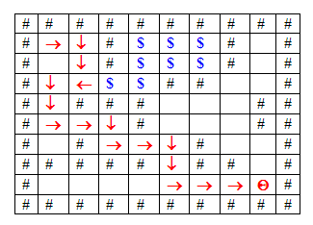
迷宫的表示

Slide 57
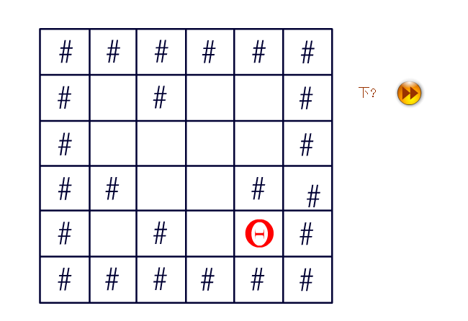
解迷宫

Slide 58
Queues
FIFO: First in, First Out
Restricted form of list: Insert at one end, remove from the other.
Notation:
Insert: Enqueue
Delete: Dequeue
First element: Front
Last element: Rear

Slide 59
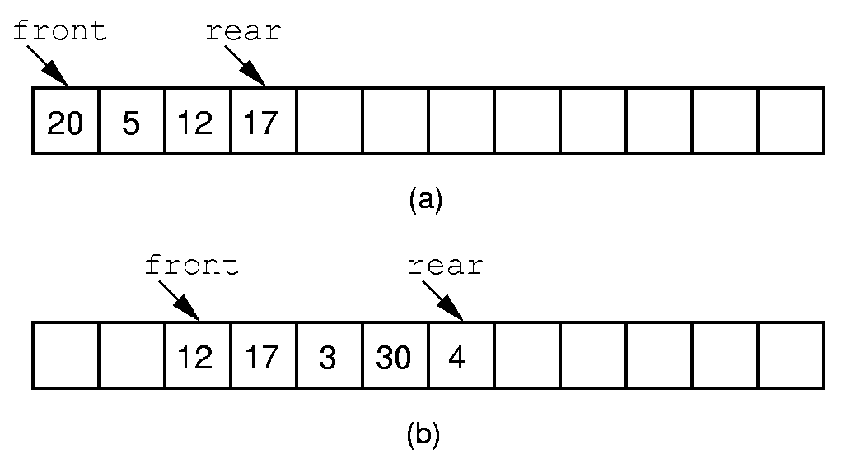
Queue Implementation (1)
Notes:
If we stick to the requirement that the queue elements be at the beginning n elements of the array, then either enqueue or dequeue must be θ(n).
Better is to let the elements “drift” within the array.
Unfortunately, as items are added and removed, the queue “drifts” toward the end. Eventually, there will be no space to the right of the queue, even though there is space in the array.

Slide 60
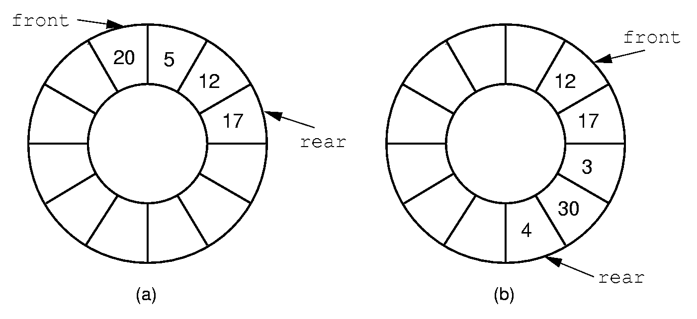
Queue Implementation (2)
Notes:
By using the mod function, we can easily achieve the effect of a “circular” queue.
This leaves one more issue. Where do the front and rear pointers go (point to the item? Or to the space before/after the item)? And, how do we distinguish a full from an empty queue?
Given a fixed position for the front element (and its pointer), there are n-1 possible states for the queue (0 through n elements in the queue for an array of size n), but only n possible positions for rear. To solve this dilemma, we must either leave an empty slot in the queue, or use and external variable to determine if the queue is empty or not.

Slide 61
循环队列 (Circular Queue)
存放队列的数组被当作首尾相接的表。
队头、队尾指针加1时从maxSize -1直接进到0，可用取模(余数)运算实现。
队头指针加1: front=(front+1) % maxSize
队尾指针加1: rear = (rear+1) % maxSize
队列初始化：front = rear = 0

Slide 62

6
7
front
6
7
front
6
7
front
rear
5
5
0
5
0
0
A
A
4
1
4
1
4
C
B
1
rear
3
2
3
2
rear
3
2
空队列
A进队
B, C进队
队空条件：rear = = front
6
7
6
7
6
7
5
5
0
5
0
0
A
4
C
B
1
4
C
B
1
4
C
1
front
rear
3
2
rear
3
2
front
rear
3
2
A退队
B退队
C退队
front

Slide 63
6
7
front
6
7
front
6
7
front
rear
5
5
0
5
0
0
A
A
4
1
4
1
4
C
B
1
rear
3
2
3
2
rear
3
2
空队列
A进队
B, C进队
队满条件：rear = = front
6
7
6
7
6
7
F
G
5
5
0
5
0
E
H
0
A
D
I
4
C
B
1
4
C
B
1
4
C
1
J
front
rear
rear
3
2
rear
3
2
front
3
2
front
A退队
B退队
D,E,F,G,H,I,J进队

Slide 64
解决：
设置计数器count，记录队列中的元素个数
设置标志表明当前队列的空满情况
在数组中始终留空一个单元不用。即front所指的单元始终不用
  队列初始化：front = rear = 0
  队空条件：front = = rear
  队满条件：(rear+1)%maxSize = = front（当队尾再加1追上队头时，队列满）

Slide 65
6
7
front
6
7
6
7
rear
5
5
0
5
0
0
队空
4
1
4
C
B
1
4
C
1
3
2
rear
3
2
front
rear
3
2
空队列
B退队
C退队
front
队空条件：rear = = front
6
7
F
G
5
E
队满
0
H
队满条件： (rear+1)%maxSize= =front
D
I
4
C
1
3
2
rear
front
D,E,F,G,H,I进队

